Slide 1
Impact of phase assemblage and grain morphology on retained austenite stability
By: Jada Fox
Summer Research Project
Anupam Saha & Timken Steel Co.

Slide 2
Introduction: Overview Of My Workings
Worked in Dr. Frame’s Lab on the Timken Steel Project
Goal: Stabilize retained austenite by increasing carbon content
Gained hands-on experience in:
Steel processing and microstructure
Metallurgical techniques (grinding, polishing)

Slide 3
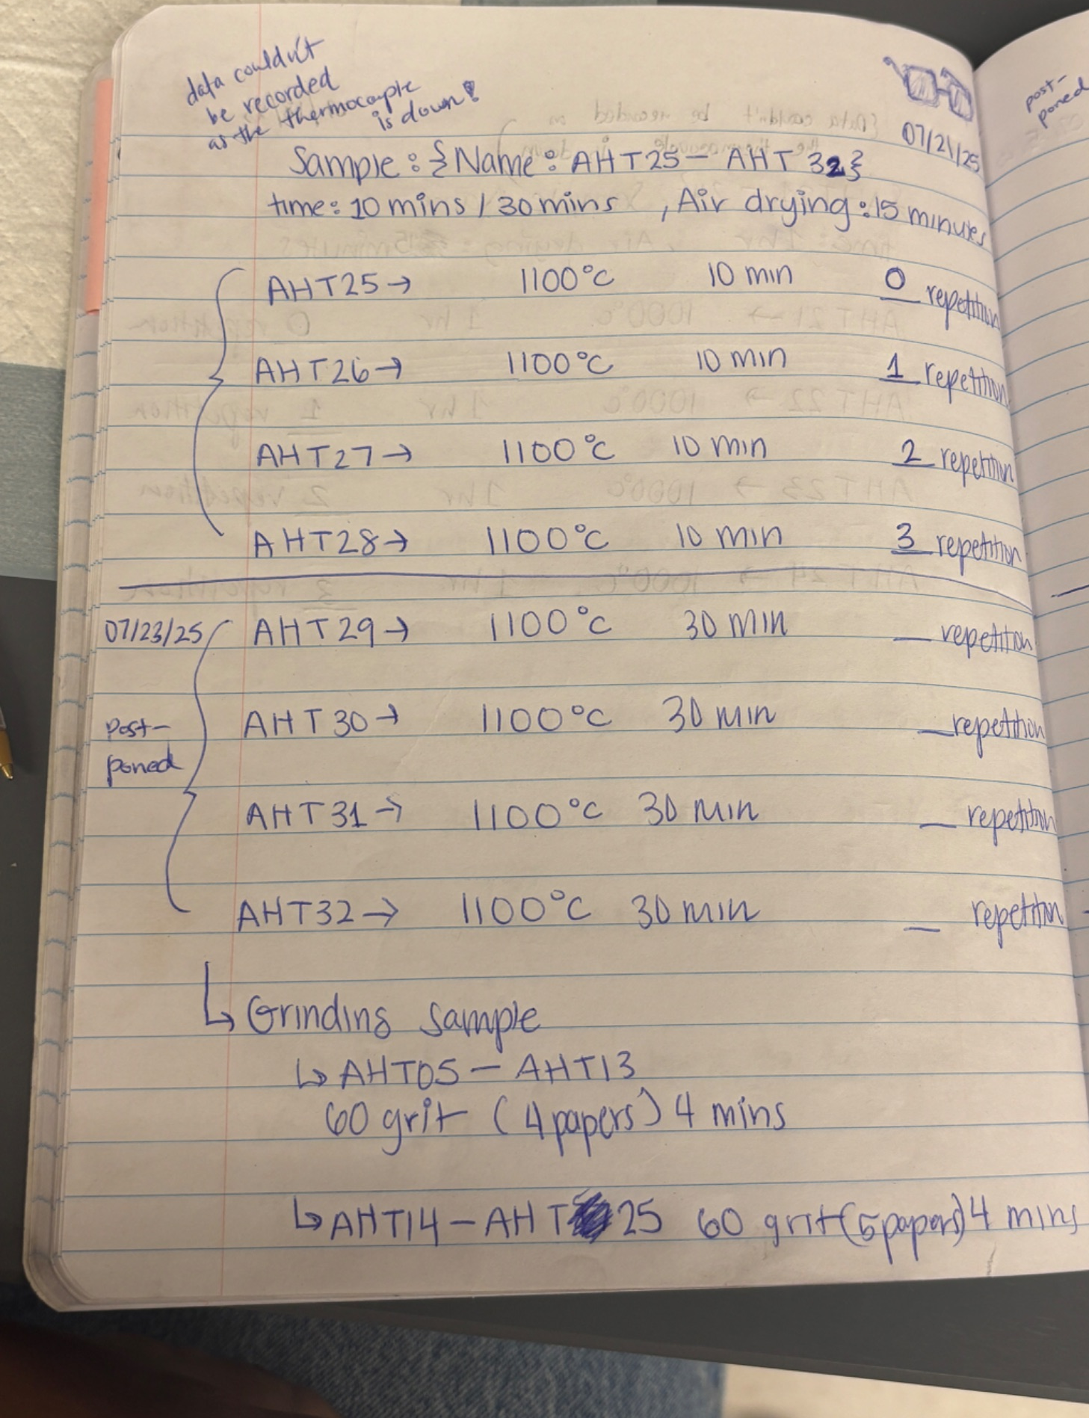
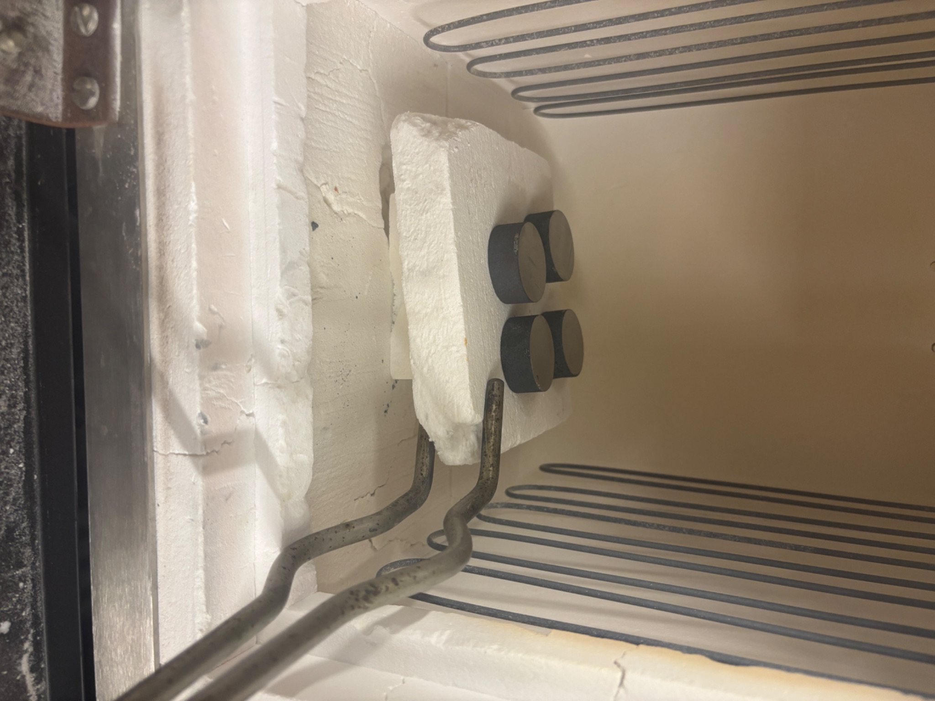
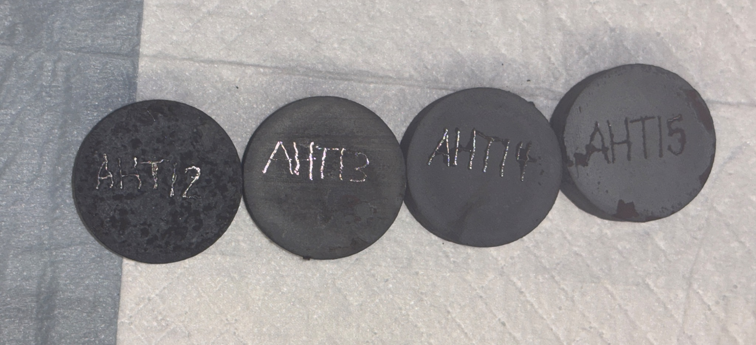
My Focus
Investigated M50 steel microstructure at:
900°C
1000°C
1100°C
Observed thermal effects on grain structure
Analyzed microstructural differences between temperatures
Sample log & Temperature records
4 metal samples heat treated & labeled
Sample placed inside new furnace
Notes:
After the heat treatments, I prepared the samples by grinding and polishing them to a smooth surface so they could be examined under a microscope.

Slide 4
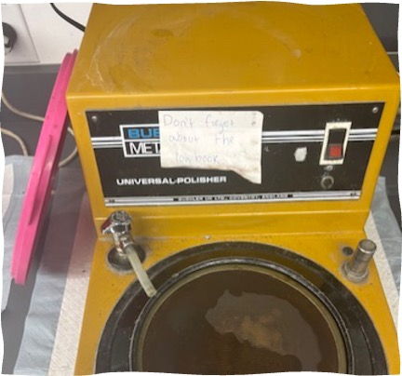
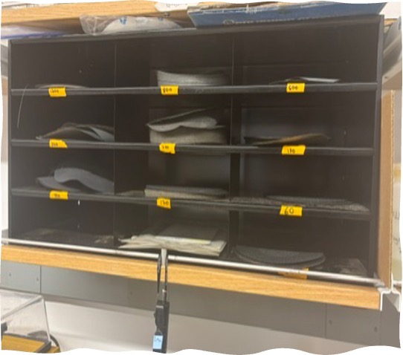
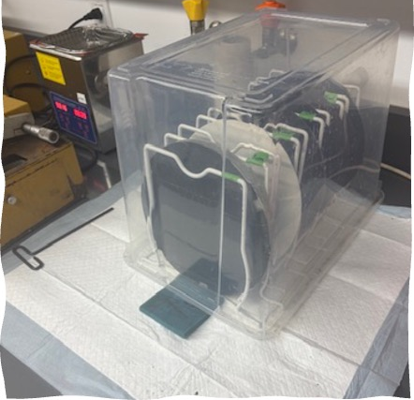
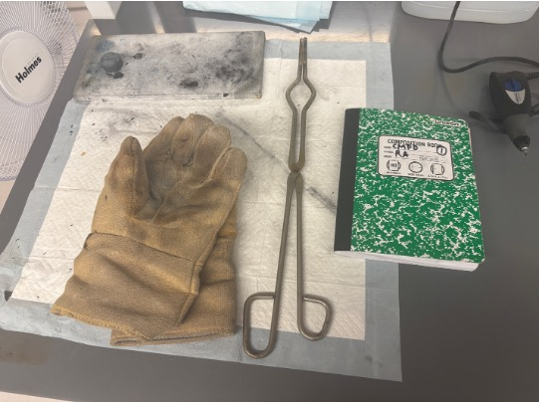
Key Techniques I learned
Grinding & polishing metal samples
Mastered:
Grit paper selection
Scratch detection
Consistent surface finish
Heat treating samples & using lab safety tools
Air quenching vs. oil quenching
Grinding/Polishing wheel I used
Various Grit sizes available for grinding
Various Polishing wheels
Safety tools required for heat treatment
Notes:
This process was essential for preparing the surface of each sample for accurate testing and evaluation. I used grit sizes varying from 60 grit to 1200 grit size. And used 9 mm to 1 mm of polishing solution. By practicing using different grit levels I learned to gradually refine the samples surface and remove imperfections.

Slide 5
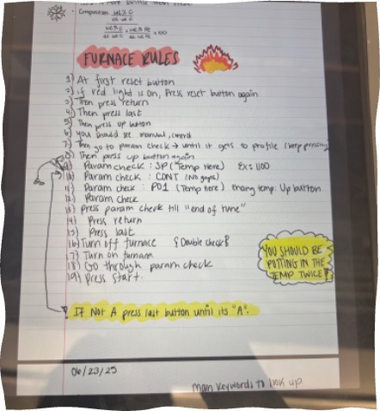
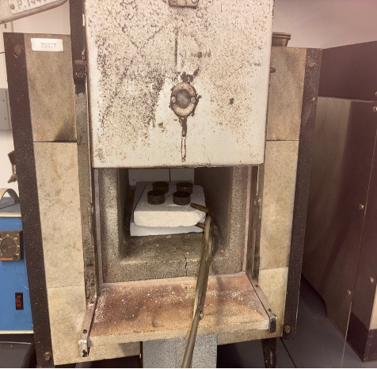
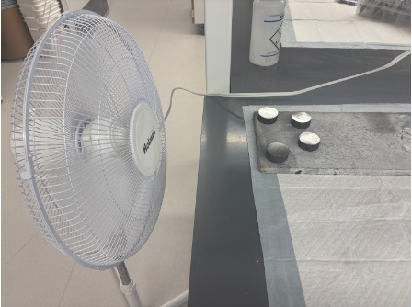
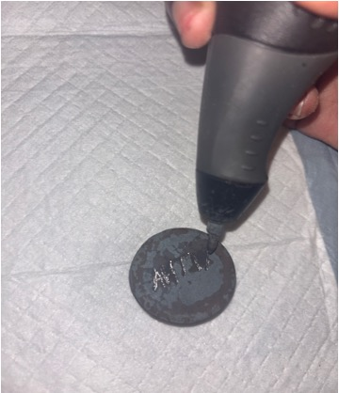
Heat Treating
•Heat treated at: 900°C, 1000°C, 1100°C
Switched from oil quenching to air quenching
Oil quenching caused cracks (rapid cooling)
Air quenching reduced cracking risk
Noticed blue oxide layer at 600°C tempering (surface oxidation)
Rules I made to safely turn on the furnace
Heat treating 4 samples at 1100℃ in Furnace
Air quenching process using a fan
Carving heat treated sample with blue tint
Notes:
To heat treat the samples, I would turn on the furnace with the help of my furnace notes and placed the 4 samples onto a brick and used the gloves and tongs( to decrease the risk of getting burned and accurate placement of the sample inside the furnace.) to place the sample inside the furnace where I would let them heat up from varying temperatures like: 10 minutes to 1 hr. Then air quench for about 15- 20 minutes with the fan and then carve the sample.

Slide 6
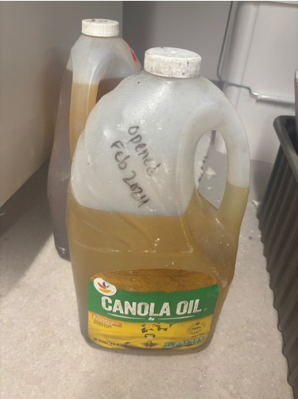
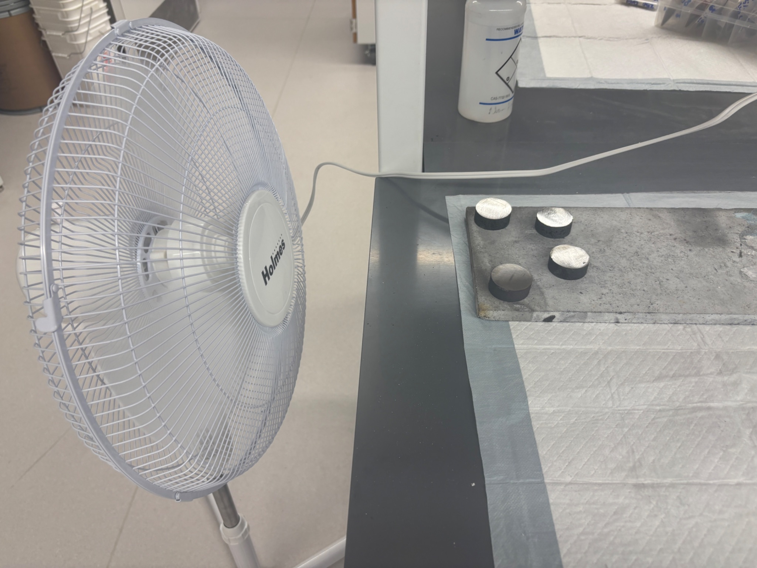
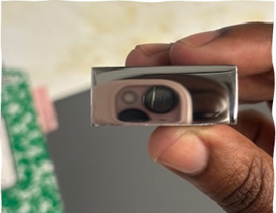
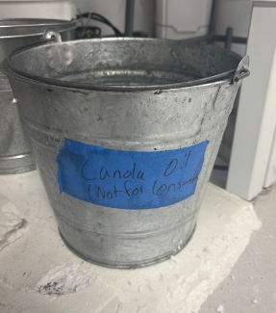
Why We Chose Air Quenching Over Oil Quenching
•Oil quench (1100°C, 60 mins) caused cracks
Air quenching = slower cooling → fewer cracks
Found Austenite % was similar in both methods
Cracked sample caused by oil quenching at 900℃
Used for initial oil quenching
Quenching medium that caused cracks
Introduction of Fan setup– had slower & safer cooling rate
Notes:
We noticed with the oil quenched samples that cracks began to form inside the sample after cooling. To prevent that we chose air quenching over oil quenching due to air quenching having a lower cooling rate. We also checked to see if the change in procedure would affect the austenite content inside the samples, we found it did not.

Slide 7
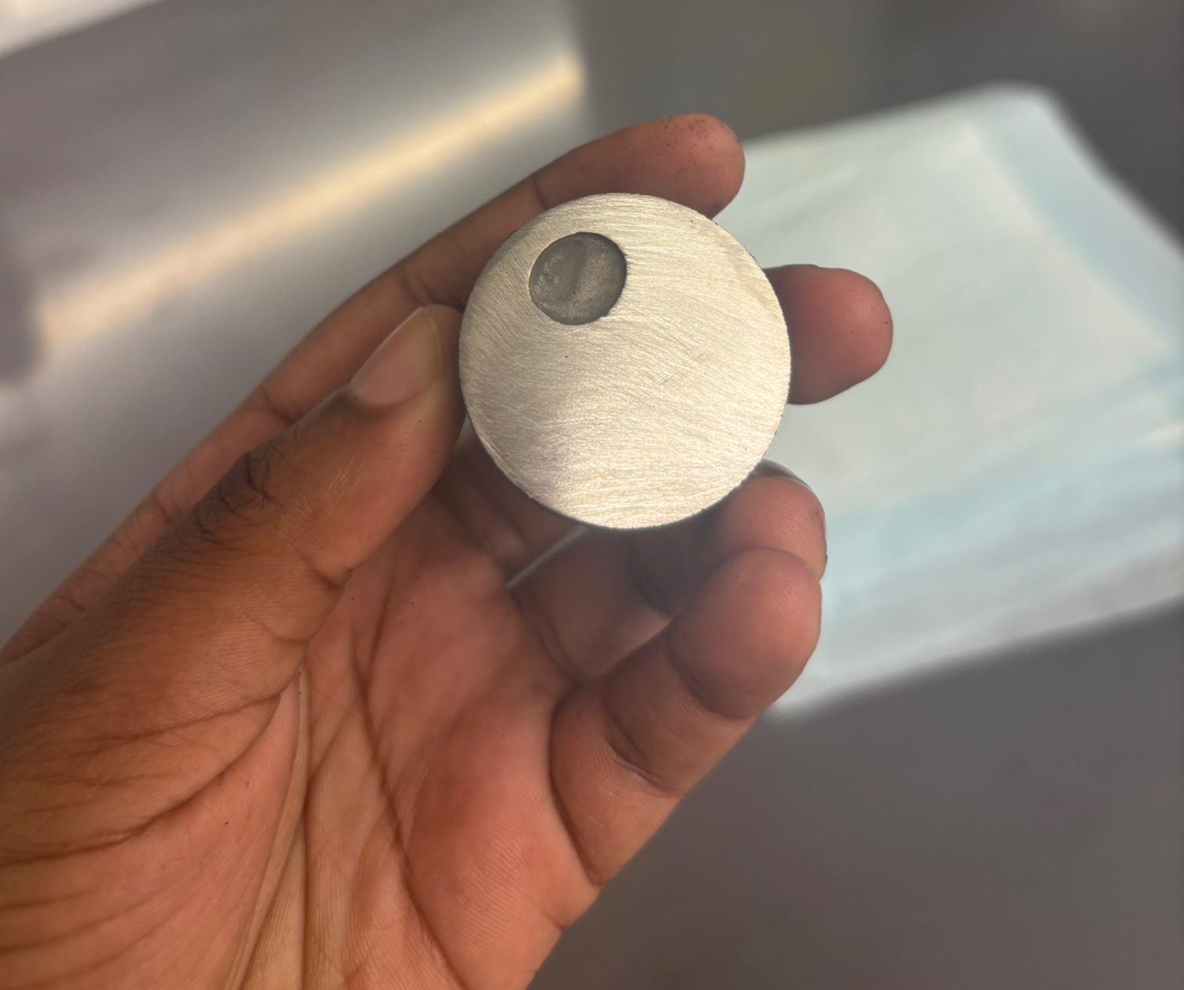
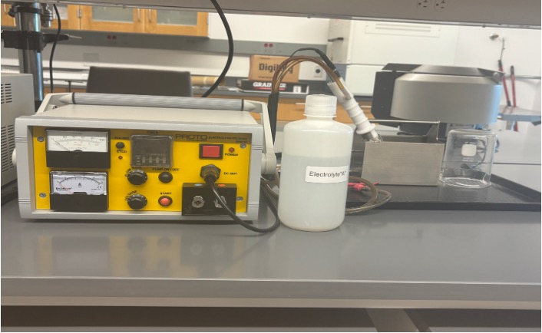
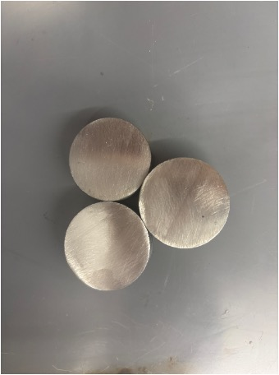
Data Analysis & Results
Learned about electropolishing (not performed myself)
Purpose:
Smooth surface post-polishing
Remove microscopic deformation
Prep for accurate microscopy
Equipment used for Electropolishing
Grinded Samples ready for electropolishing
Sample electropolished and ready for microscopy
Notes:
In metallurgy, this step is essential for revealing the true microstructure of a metal, especially when using techniques like microscopy or surface characterization. Understanding this process helped me connect the importance of surface preparation to the overall quality of materials research and gave me a deeper appreciation for how precision and cleanliness affect results.

Slide 8
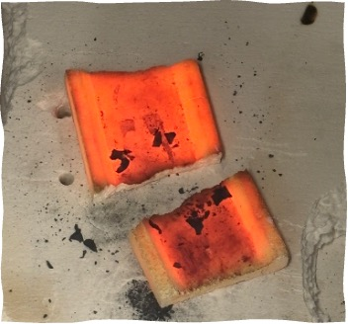
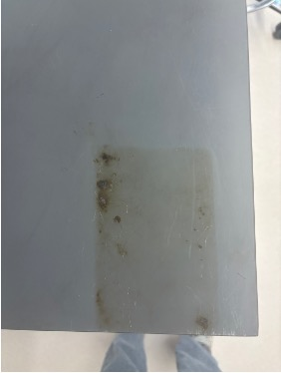
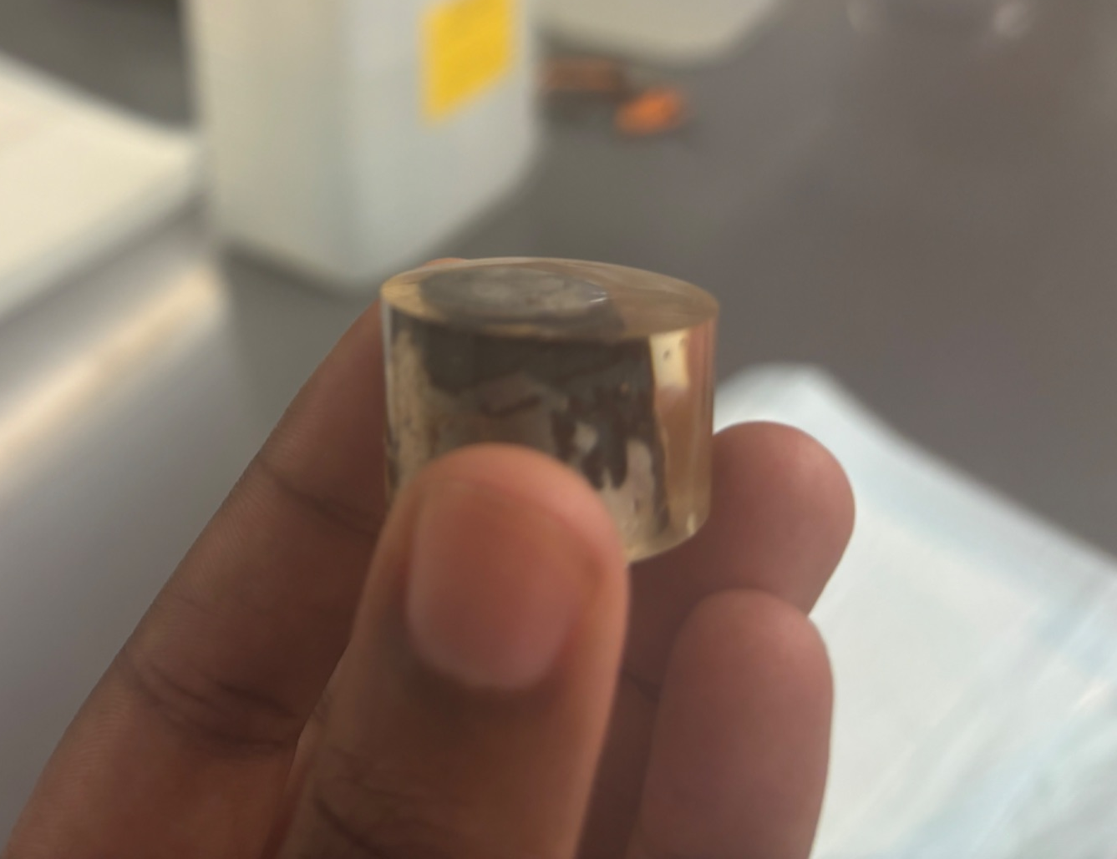
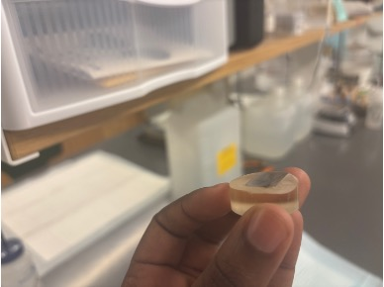
Personal Struggles
Struggled with polishing in early stages
Common issues:
Uneven Grinding
Handling hot objects
Recognizing proper finish
Brick cracking after very last heat treatment– possibly due to repeated cycles of heat treatments.
Burn mark left on table– due to mishandling of hot brick with heated samples.
Early stages of grinding– showcasing uneven surface
Another example of uneven surface grinded into the sample
Notes:
At the beginning, I struggled with the polishing process. It was hard to know when a sample was even and flawless, in the beginning I would sometimes leave behind scratches or not grind evenly. . I also found the heat-treating process overwhelming at first, I’ve never handled hot metals and furnace workings before, so I was terrified of messing up the sample or breaking the furnace.

Slide 9
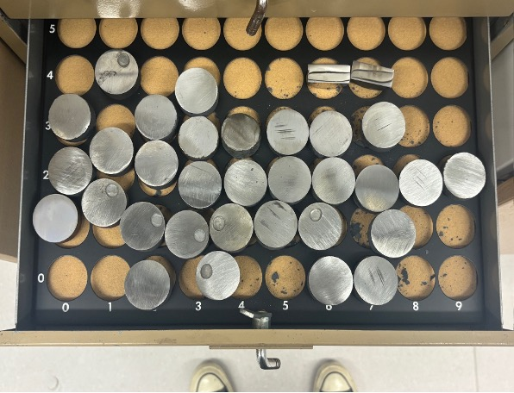
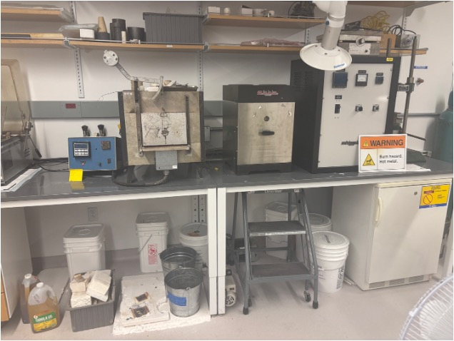
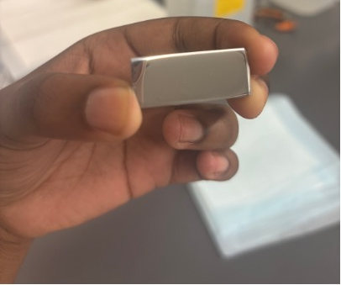
How I Grew
Gained confidence with lab tools
Improved micrograph interpretation
Learned:
Troubleshooting techniques
Lab discipline and consistency
Tray of over 30+ evenly grinded and heat treated samples
Initial furnace broke down– due to my heat treatment skills I was able to successfully move the bigger furnace without any issues.
One of the samples I grinded and polished with no imperfections or cracks
Notes:
By the end of the summer, I was able to prepare high-quality samples. There was a moment where the furnace I spent most of the summer working on broke down, but was able to smoothly transition to a furnace I never used before and continued heat treating. To improve my grinding skills I raised my elbows higher on the grinding wheel which helped create equal pressure on the sample.

Slide 10
Broader Impacts & Reflections
•Overall, my time in Dr. Frame’s lab was challenging but incredibly rewarding. I started with very little lab experience, and by the end, I had completed a full research cycle from preparing samples to analyzing results. I’m proud of how far I came and how much I learned, both technically and personally. This project pushed me to think critically, stay persistent, and believe in my ability to figure things out, even when it wasn’t easy. I got hands-on exposure to industry-relevant testing methods and heat treatments, and now I feel much more prepared for future internships or research opportunities.

